Slide 1
MR3 Performance Enhancement

Slide 2
Agenda
Database Improvement
Memory Improvement
Disk Space Improvement
Notes:
https://www.codeproject.com/Articles/3171/SQL-Server-DO-s-and-DONT-s-8

Slide 3
Useless Database Objects (Remove)
VIEWS
- AFP_View_AvailablePatient
- AFP_View_AvailableStudy
- AFP_View_FilmMediaSize
- AFP_View_ForbiddenFilm
- AFP_View_FilmsToPrintSI
- AFP_View_FilmsToPrintSIWithoutHoldingTime
- AFP_View_PrintTaskStatus
- AFP_View_UnprintedFilm
- AFP_View_UnprintedReportBySTUID
- AFP_View_UnprintedReportBySTUIDWithoutHoldingTime
- AFP_View_UnreportedFilm
- AM_V_AlarmMessageList
- AM_V_DispatchGroupJoinReceiver
PROCEDURES
AM_SP_Batch_Insert_Alarm_Dispatch_P3F
AM_SP_Batch_Insert_AlarmDispatch
AM_SP_IngoreAlarmStatus
AM_SP_QueryAlarmList
AM_SP_QueryDispatchList
AM_SP_QueryP3FAlarmList
AM_SP_UpdateEmailDispatchStatus
AM_SP_UpdateP3FDispatchStatus
AM_SP_UpdateSMSDispatchStatus
AFP_SP_GetBulletinList
TABLES
- Alarm_Dispatch
- Alarm_Dispatch_P3F
- Alarm_Message
- Alarm_ReceiverList
- AFP_WorkingCalendar

Slide 4


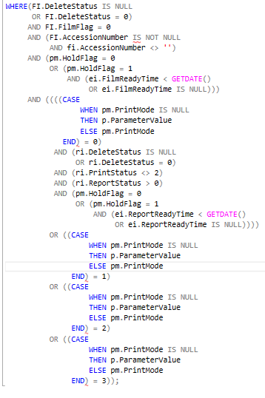
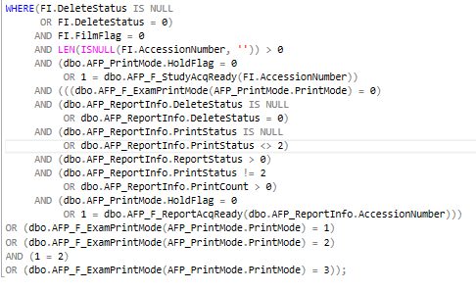
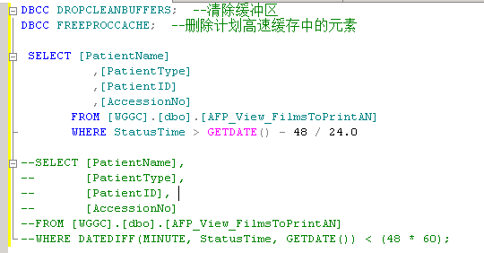
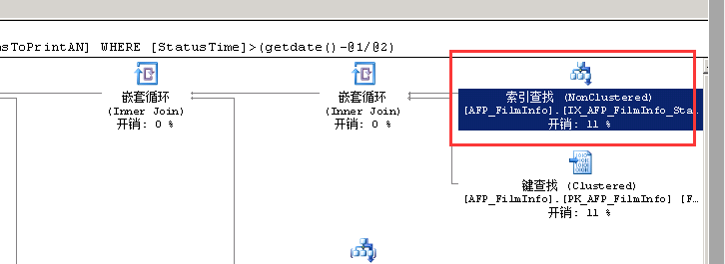
Views need be refined
Enhancements
Remove functions from WHERE clause below 4 views and AFP_SP_Query_eFilmWorklist_BulletinList
Add non-clustered index on PatientId of AFP_ReportInfo, PatientId of AFP_FilmInfo, StatusTime of AFP_ReportInfo, StatusTime of AFP_FilmInfo
- AFP_View_FilmsToPrintAN
- AFP_View_FilmsToPrintANWithoutHoldingTime
- AFP_View_UnprintedReportByAccNo
- AFP_View_UnprintedReportByAccNoWithoutHoldingTime
Notes:
SELECT DISTINCT PatientID,PatientName
FROM WGGC.dbo.AFP_View_FilmsToPrintAN
WHERE @AvailableTime=-1 OR DATEDIFF(MINUTE,cast([StudyDate]+' '+substring([StudyTime],1,2)+':'+substring([StudyTime],3,2)+':'+substring([StudyTime],5,2) as datetime),GETDATE())<@AvailableTime*60
UNION
SELECT DISTINCT patientID,PatientName
FROM wggc.dbo.AFP_View_UnprintedReportByAccNo
WHERE @AvailableTime=-1 OR DATEDIFF(MINUTE,dbo.AFP_View_UnprintedReportByAccNo.StatusTime,GETDATE())<@AvailableTime*60
and len(isnull(patientID,''))>0
SELECT [PatientName]
,[PatientType]
,[PatientID]
,[AccessionNo]
,Modalities AS ModalityType
,MAX(StatusTime) AS StudyDate
,COUNT(*) AS FilmCount
FROM [WGGC].[dbo].[AFP_View_FilmsToPrintAN]
WHERE DATEDIFF(MINUTE,StatusTime,GETDATE())<(@AvailableTime*60)
GROUP BY [PatientName],[PatientID],[AccessionNo],Modalities,[PatientType]
SELECT [PatientName]
,[PatientType]
,[PatientID]
,[AccessionNumber] AS AccessionNo
,ModalityType
,MAX(StatusTime) AS StudyDate
,COUNT(*) AS ReportCount
FROM [WGGC].[dbo].[AFP_View_UnprintedReportByAccNo]
WHERE DATEDIFF(MINUTE,StatusTime,GETDATE())<(@AvailableTime*60)
GROUP BY [PatientName],[PatientID],[AccessionNumber],ModalityType,[PatientType]

Slide 5
Trigger Enhancements
Option 1
Add triggers’ logic when application insert or update or delete exam/report/film
Option 2
Simplify trigger logic, only insert a event to queue table, then start a new backend thread to process events
AFP_DbTriggerEvents
Id, TriggerSource, TriggerType, Status, CreateTime, UpdateTime
Option 3
Start a new thread to load exam/report/film into memory, calculate status/count/others, then update into database
Notes:
Remove when update exam t

Slide 6
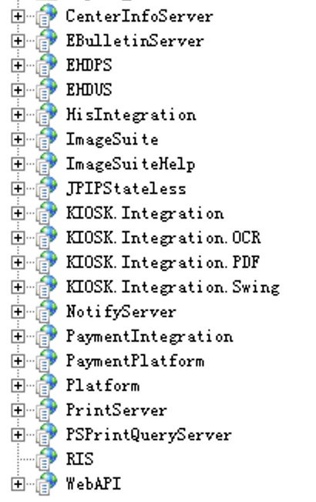
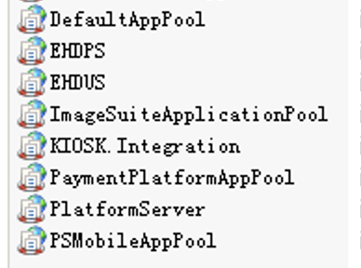
Kiosk Web App Pool Structure
Data Web API framework
Swagger integrated
Entity Framework
Cache supported
Web app in red rectangle will be removed
9 web pools will be decreased
Consider to change app pool of kiosk integration to 32 bit and limit memory usage?
Remove backend service, Imagesuite Alarm Service and Monitor Service
Notes:
RIS removed
HIS Integration removed
ImageSuiteHelp removed
JPIPSateless removed?
Change app pool of kiosk integration to 32 bit and limit memory usage
Imagesuite Alarm Service and Monitor service remove

Slide 7
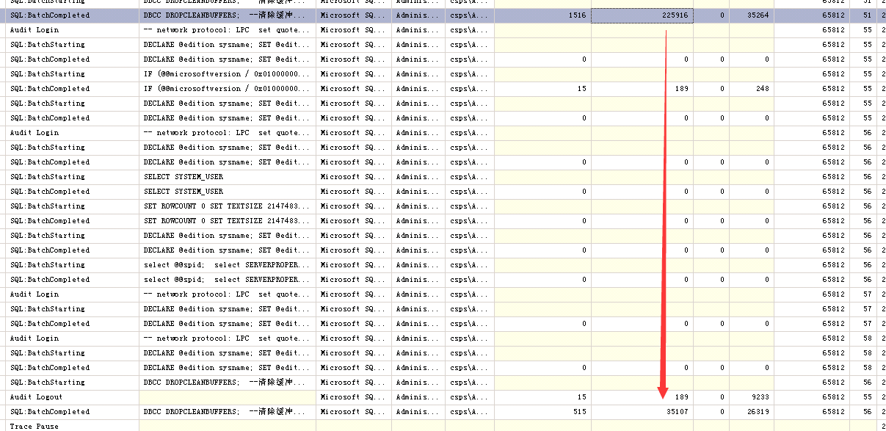
Notes:
RIS removed
HIS Integration removed
ImageSuiteHelp removed
JPIPSateless removed?
Change app pool of kiosk integration to 32 bit and limit memory usage
Imagesuite Alarm Service and Monitor service remove

